Slide 1

HQC Teamwork
Team “Bulls-and-Cows-2”

Slide 2
The team
Gergana Damyanova
Ivaylo Hristov
Ivailo Papazov
Lubomir Angelov
Stefan Mirevski
Stefan Petrov
Stefan Vladkov

Slide 3
ЖитХюб repository: https://github.com/TeamBullsAndCows2/HQC-Team-Project---Bulls-and-Cows

Slide 4
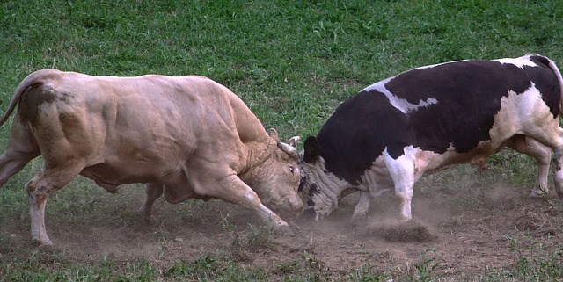
The game

Slide 5
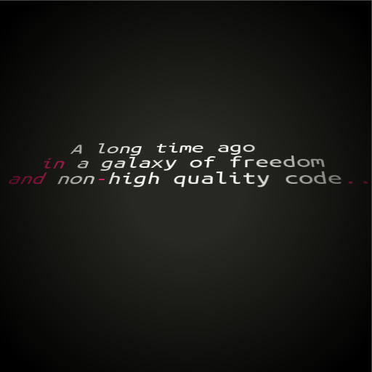

Slide 6
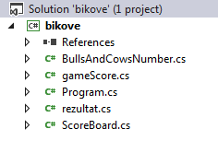

Slide 7
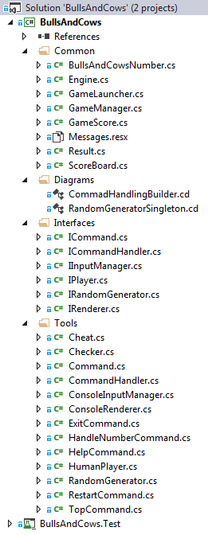

Slide 8
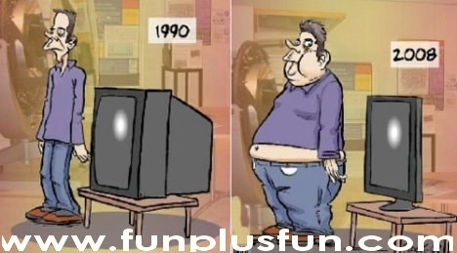

Slide 9



